Slide 1

Idea to Production Demo
“An idea in the morning…in production by afternoon”
Notes:
While this concept is not new, for people on the .NET side, this was never seen as feasible in a large enterprise because of what it took to actually test and deploy an application using the Microsoft stack. PCF changes the game. Not only is it feasible, we make it very easy for .NET teams to take advantage of the scalability, security, and high availability of the PCF platform.

Slide 2
Goal of this demo
Demonstrate in less than 5 minutes how easy it can be to create a new .NET Core or .NET Framework application and then deploy on Pivotal Cloud Foundry and available on the internet

Slide 3
Target Audience
Customer prospects or existing customers with .NET applications who are not aware of our great support for .NET on PCF

Slide 4
Situation
Customer prospect or existing customer approaches PA and asks “How difficult is it to get .NET applications to run on PCF?”.
Notes:
PA should request what type of .NET application to demonstrate and use a new .NET Core project or .NET Framework application project for the demo

Slide 5
Key Talking Points
.NET 4.x support (web apps, web services, console apps) on Windows – a platform for companies to “Move and Improve” their critical .NET workloads
.NET Core support (web apps, web services, console apps) on Windows or Linux
Resource and namespace isolation on Windows
Easily integrates into existing CI/CD Pipelines
Connect to service brokers for application services
Native support for health monitoring, autoscaling, log aggregation, container metrics, and more
Microsoft supported and is an investor in Pivotal
Notes:
where to run it → .NET on PCF
.NET Framework on Windows (runs in Garden-Windows container)
.NET Core on Linux

Slide 6
Demo Overview
Create a new .NET Core or .NET 4.6x project
Configure the project to show all files
Publish the project using the Folder profile
Open the command prompt at the publish location
Push the application on to PCF
While the push is completing, explain what is happening during the process
Open the Apps Manager UI and show the pushed app
Launch the app and show the logs for the application
Scale the application (number of instances, memory, and disk)
Show off cf ssh capabilities

Slide 7
Prerequisites
Visual Studio 2017 (Any Edition)
Cloud Foundry Command Line (cf.exe)
Install Open Command Line Extension for Visual Studio (optional)
https://marketplace.visualstudio.com/items?itemName=MadsKristensen.OpenCommandLine
Cloud Foundry Environment with Windows 2016 Stem Cell

Slide 8
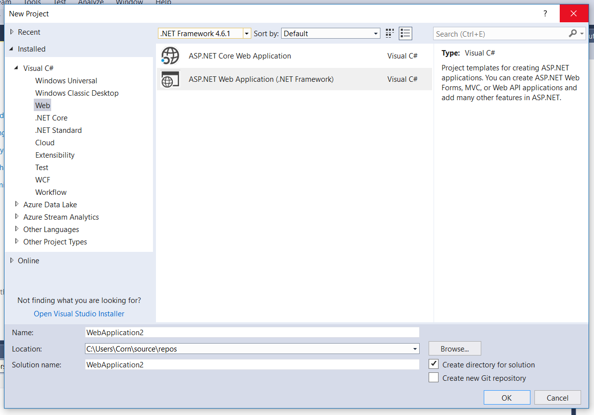
Create new project

Slide 9
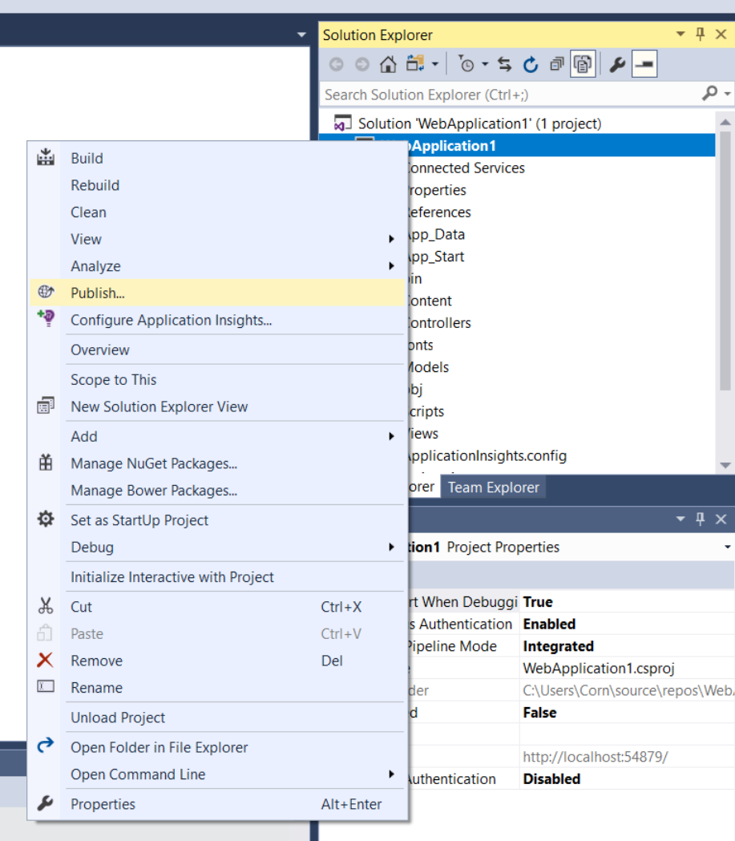
Publish the project

Slide 10
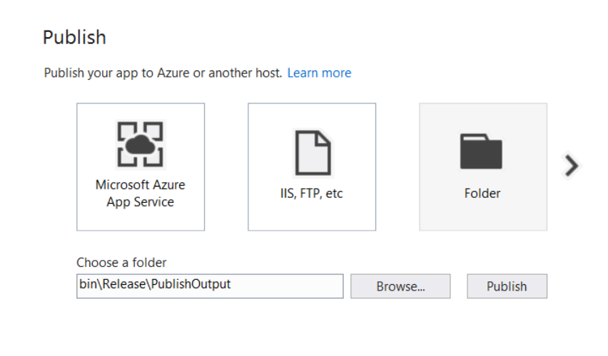
Use Folder Profile

Slide 11
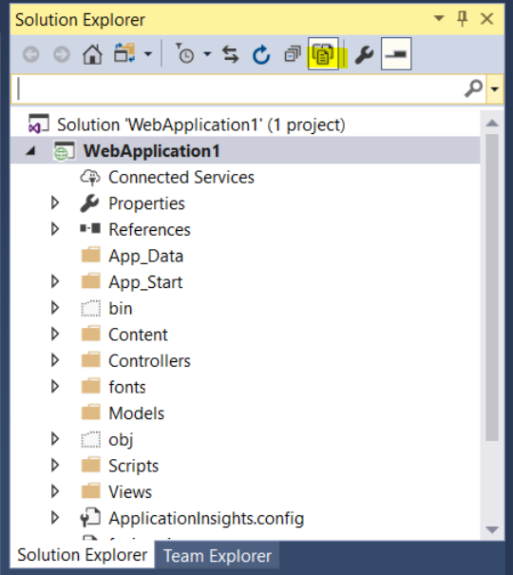
Show all project files

Slide 12
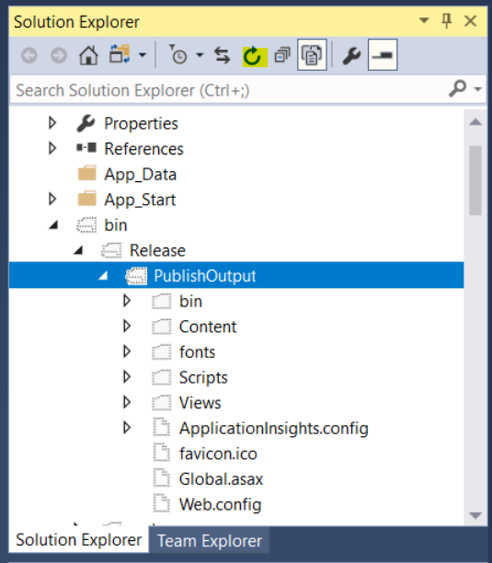
Locate the publish location

Slide 13
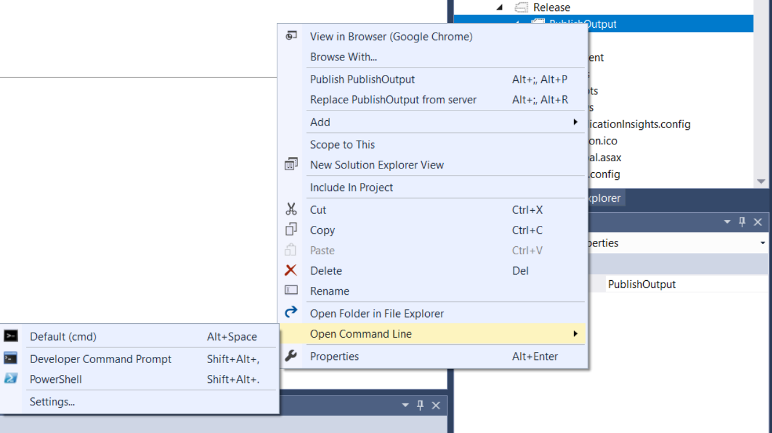
Open command line at the location

Slide 14
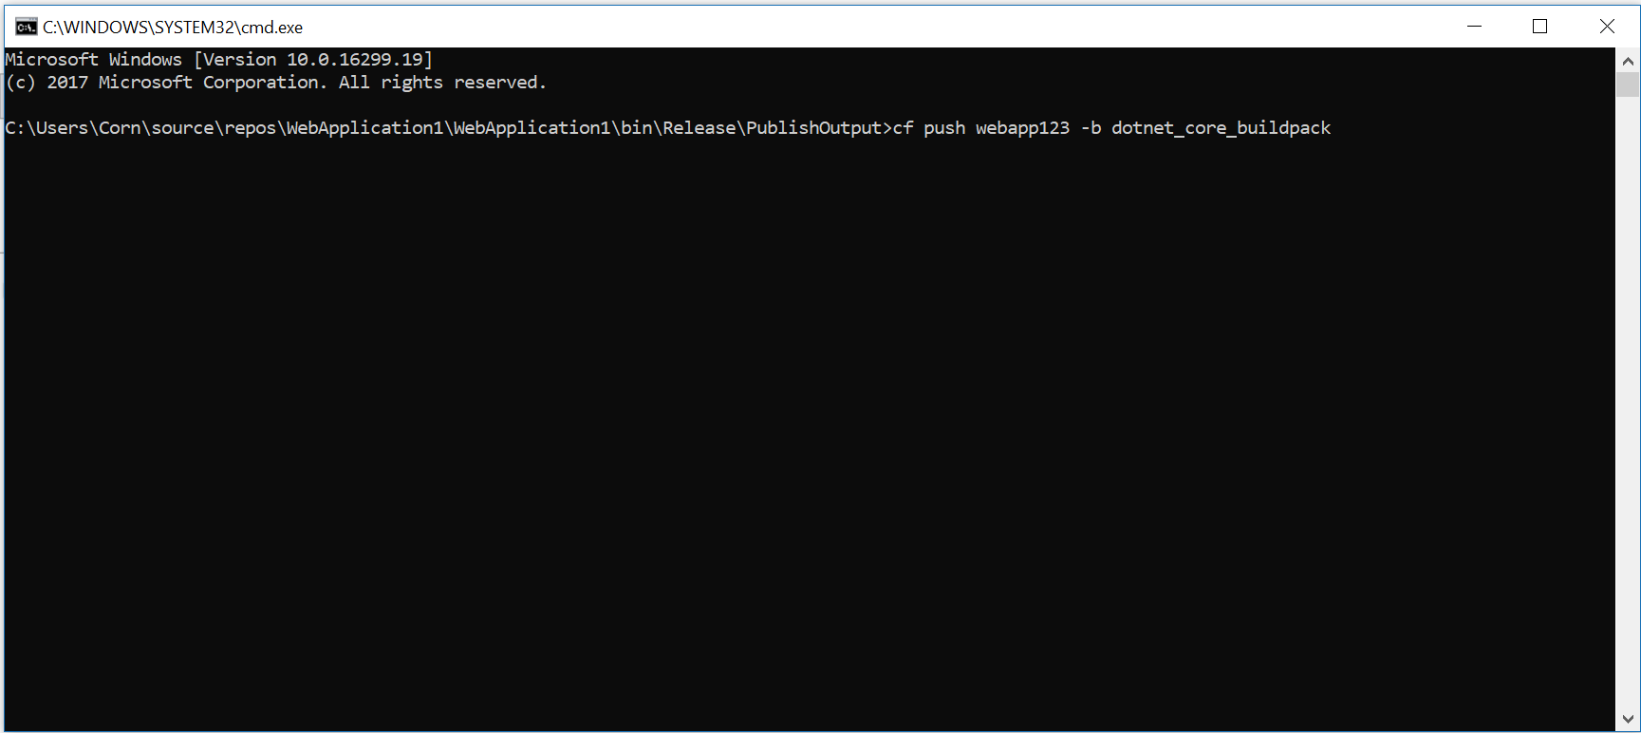
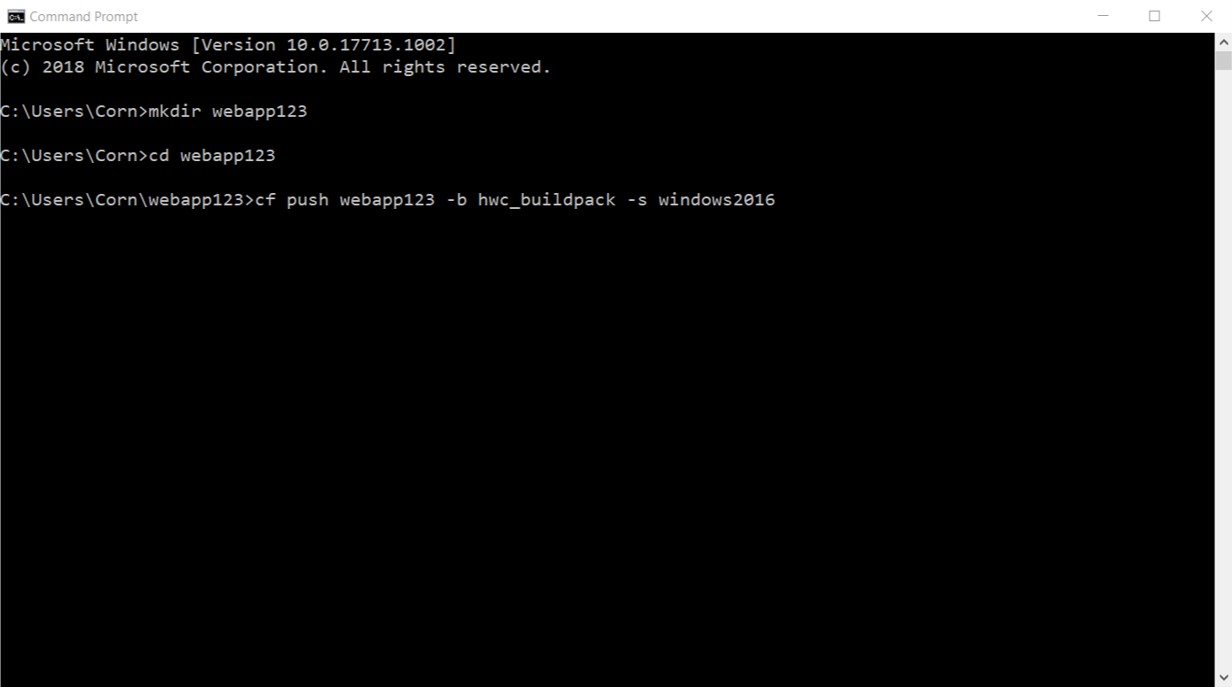
Push the application
For .NET Core
For .NET Framework
Notes:
.NET Framework on Windows
C:> cf push {appname} –b hwc_buildpack –s windows2016
.NET Core on Linux
C:> cf push {appname} –b dotnet_core_buildpack
Or
C:> cf push {appname} –b https://github.com/cloudfoundry/dotnet-core-buildpack.git

Slide 15

Code Complete & Tested
Find available hosts
Install & configure runtime
Install & configure middleware
Pull application source code
Retrieve dependent libraries
Create application package
Install, configure dependent service(s)
Deploy container to host(s)
Load environment variables
Configure load balancer
Configure firewalls
Update service monitoring tools
Configure log collector
45
seconds
later
~$ cf push
Application in Production
Notes:
While the application is being pushed, spend time discussing what is going on during the push of the application

Slide 16
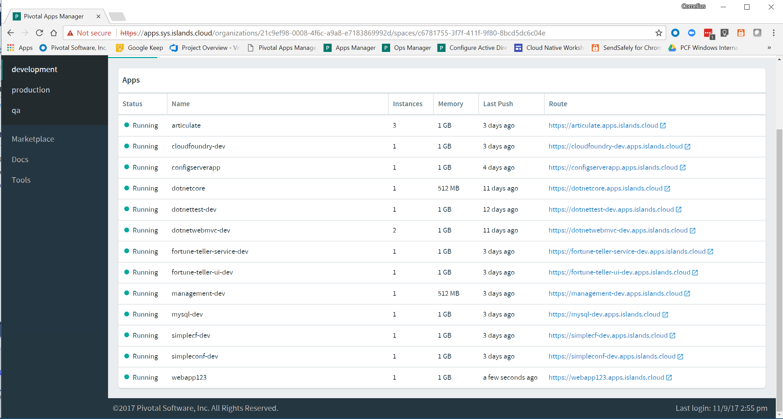
Open Apps Manager and locate app

Slide 17
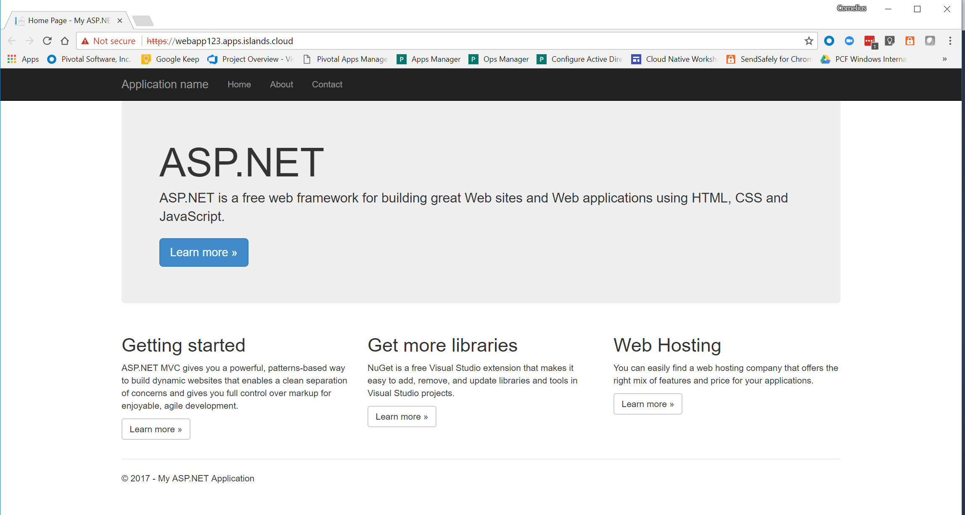
Launch the app

Slide 18
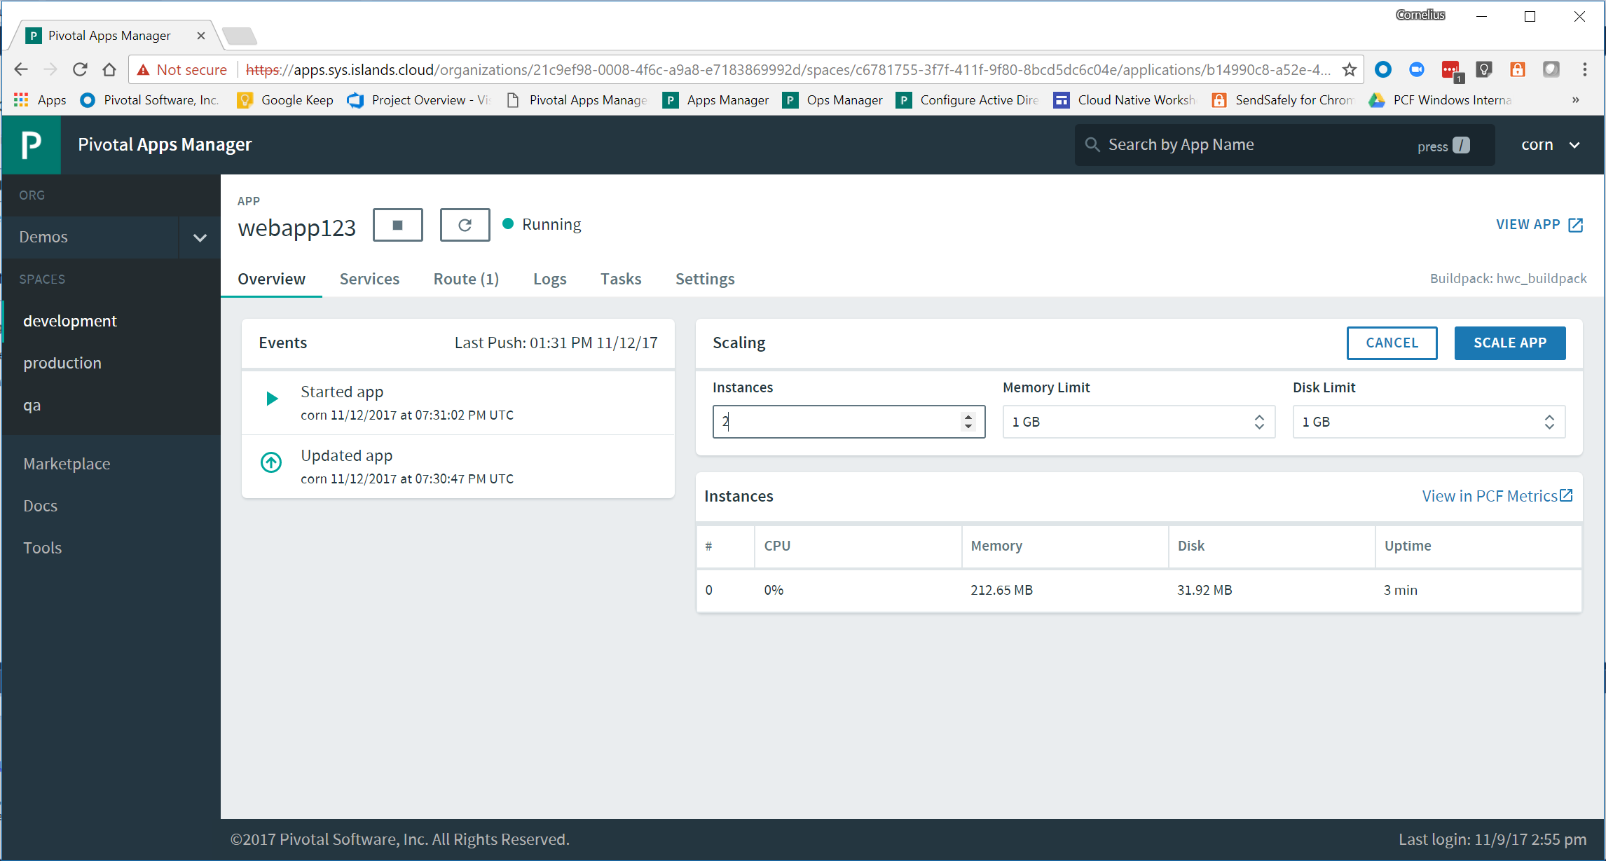
Scale the app
Notes:
PCF provides a secure, highly available platform for applications. .NET applications can take advantage of the scalability and zero-downtime capabilities of the platform.

Slide 19
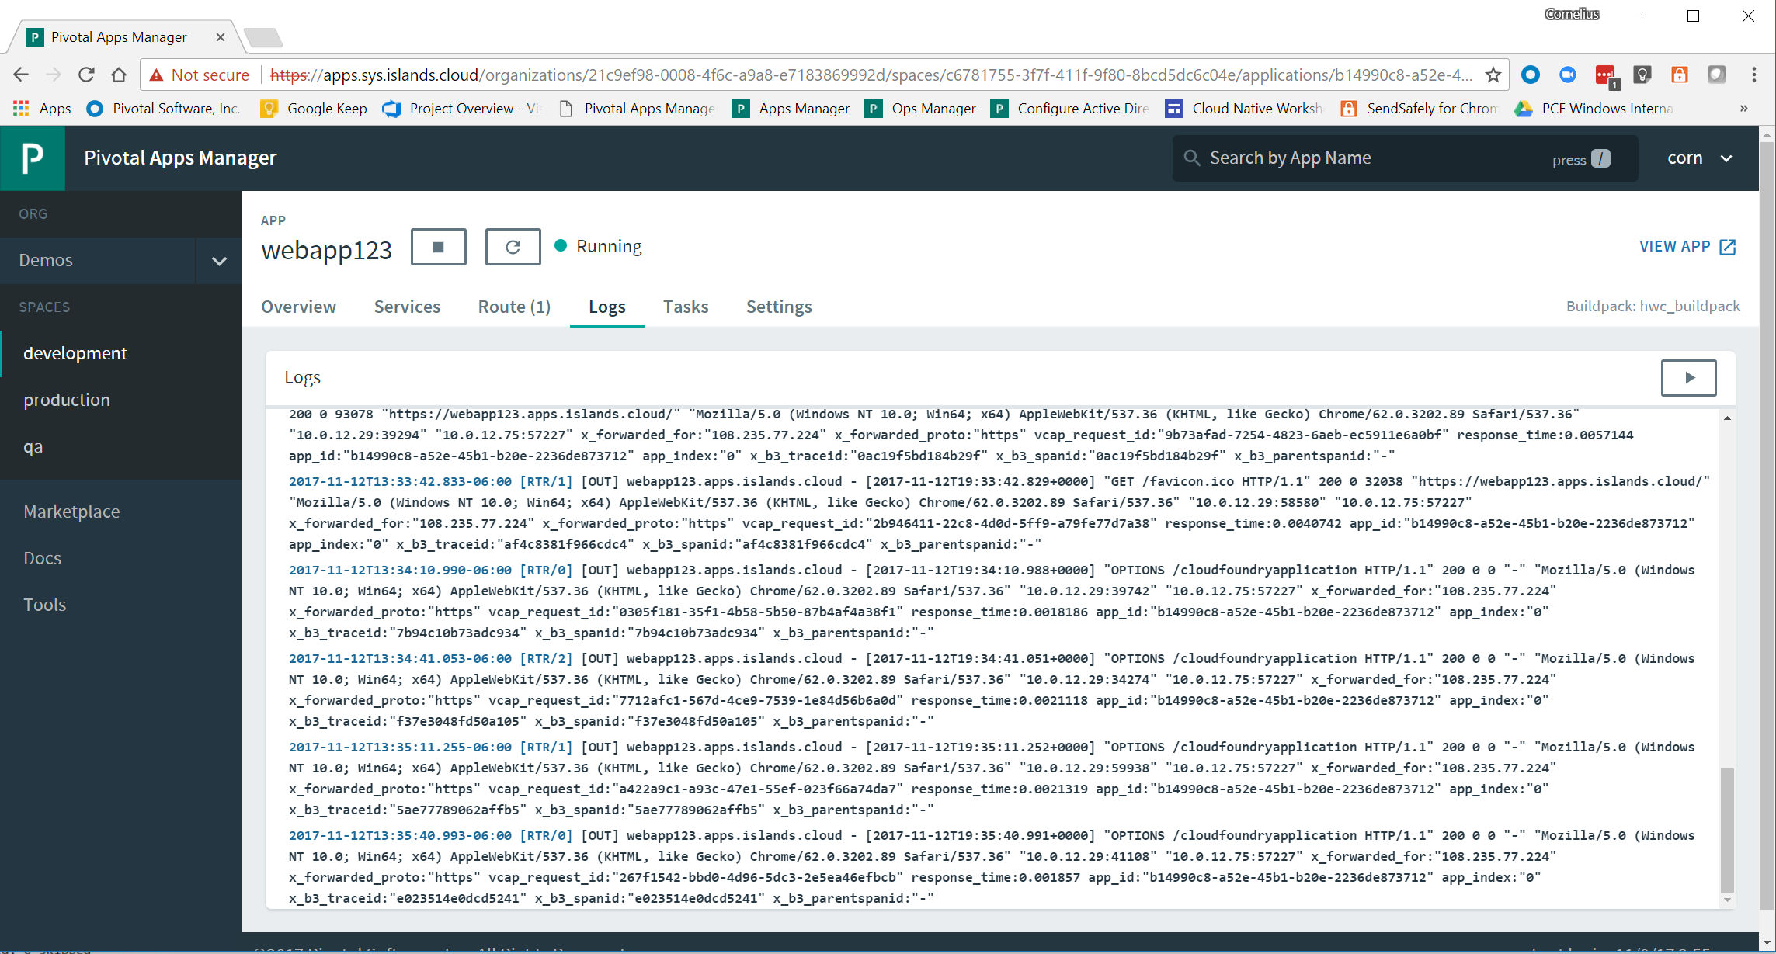
Show the logs for the app
Notes:
PCF provides integrated logging facilities that give .NET developers detailed logging by application instance

Slide 20
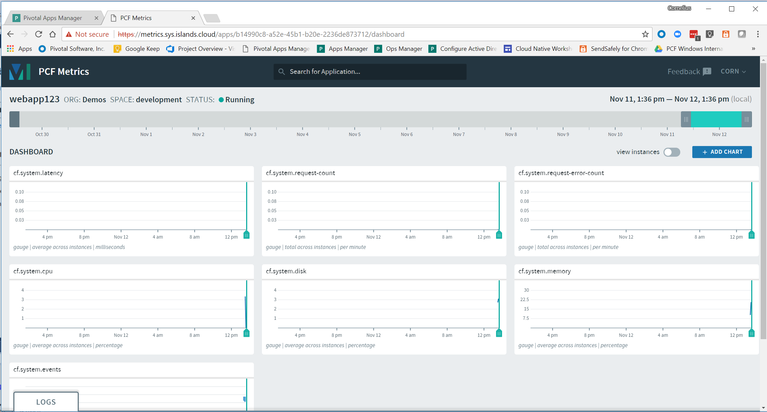
Show the metrics for the app
Notes:
PCF provides a robust set of metrics and data for .NET application developers

Slide 21
cf ssh into the application
“cf ssh” is now available on PAS Windows which enables developers more flexibility in testing and debugging their .NET Framework applications
Open a command window and “cf ssh” into the application to show the file structure and how it mimics a physical or virtual server which helps ensure workload compatibility
cf ssh can be used to help troubleshoot applications and also test functionality within the running container
Notes:
PCF provides a robust set of metrics and data for .NET application developers

Slide 22
Summary
PCF provides .NET developers a platform agnostic, highly available, highly secure Enterprise Cloud platform for running .NET Framework and .NET Core applications

